Slide 1
Random Forest Spatial Interpolation
David S. Lamb
Center for Urban Transportation Research
School of Geosciences
University of South Florida
Notes:
Where you are from
Title talk, preliminary work

Slide 2
Overview
Previous Studies
Research Question
Random Forest Methodology
Results
Conclusions and Guidelines
Notes:
Will talk about some of the previous work in this area
My intent with the analysis
Briefly cover random forest methods, assume some familiarity with decision trees
Cover the results and conclusions

Slide 3
Random Forest -> Tree-based methods in Spatial Interpolation/Prediction
Primarily in Environment and Ecological applications (Elith, Leathwick, and Hastie 2008)
Applied to Classification or Regression problems (CART)
Appelhans et al. (2015) Compared 14 Machine Learning algorithms to Universal Kriging (UK) of air temperature. Tree-based methods outperformed UK (stochastic gradient boosting)
Li et al. (2011) Compared 23 algorithms and found Random Forest to perform well, particularly when combined with kriging.
Prediction may be made for a continuous raster grid, or at individual locations (see for example Liu, Wei, Peijun Du, and Dongchen Wang. 2015. “Ensemble learning for spatial interpolation of soil potassium content based on environmental information.” PloS one 10 (4): e0124383)
Notes:
Two main articles, comparing numerous machine learning approaches to a baseline popular approach in Kriging
Discussing prediction of unknown values across a raster grid. In some cases it may to be prediction at discrete locations.

Slide 4
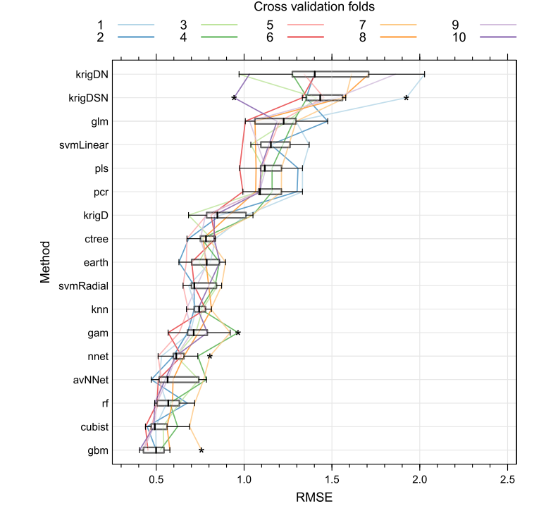
Appelhans, Tim, Ephraim Mwangomo, Douglas R. Hardy, Andreas Hemp, and Thomas Nauss. 2015. “Evaluating machine learning approaches for the interpolation of monthly air temperature at Mt. Kilimanjaro, Tanzania.” Spatial Statistics 14: 91–113.
Notes:
Here is the results from the Appelhans comparison looking at monthly air temperature
Kriging plus explanatory variables at the top, uses kriged surfaces like DEM for part of the prediction
Trees at the bottom. Less variability.

Slide 5
Advantages of Random Forest Approach
Internal unbiased estimate of the prediction error*
The ability to handle complex data of different statistical distributions*
The capability to use categorical predictors [and numerical]*
The capability to determine variable importance [although may have problems with highly correlated variables]*
Automatically models interaction between variables
Large datasets
*Rodriguez-Galiano, V. F., M. Chica-Olmo, and M. Chica-Rivas. 2014. “Predictive modelling of gold potential with the integration of multisource information based on random forest: A case study on the Rodalquilar area, Southern Spain.” International Journal of Geographical Information Science 28 (7): 1336–54.

Slide 6
Research
Why is Random Forest performing well?
How does Random Forest perform as a standalone interpolation method?
Spatial dependence <- not inherent in the method
How does explanatory variables with missing values affect the results?
Sample size

Slide 7
Methods
Simulated –
Multivariate Normal Distribution <- not shown
Single peak surface
Guassian Random Field
Variable surface with peaks and valleys
Guassian Random Field with Explanatory Variable
Variable

Slide 8
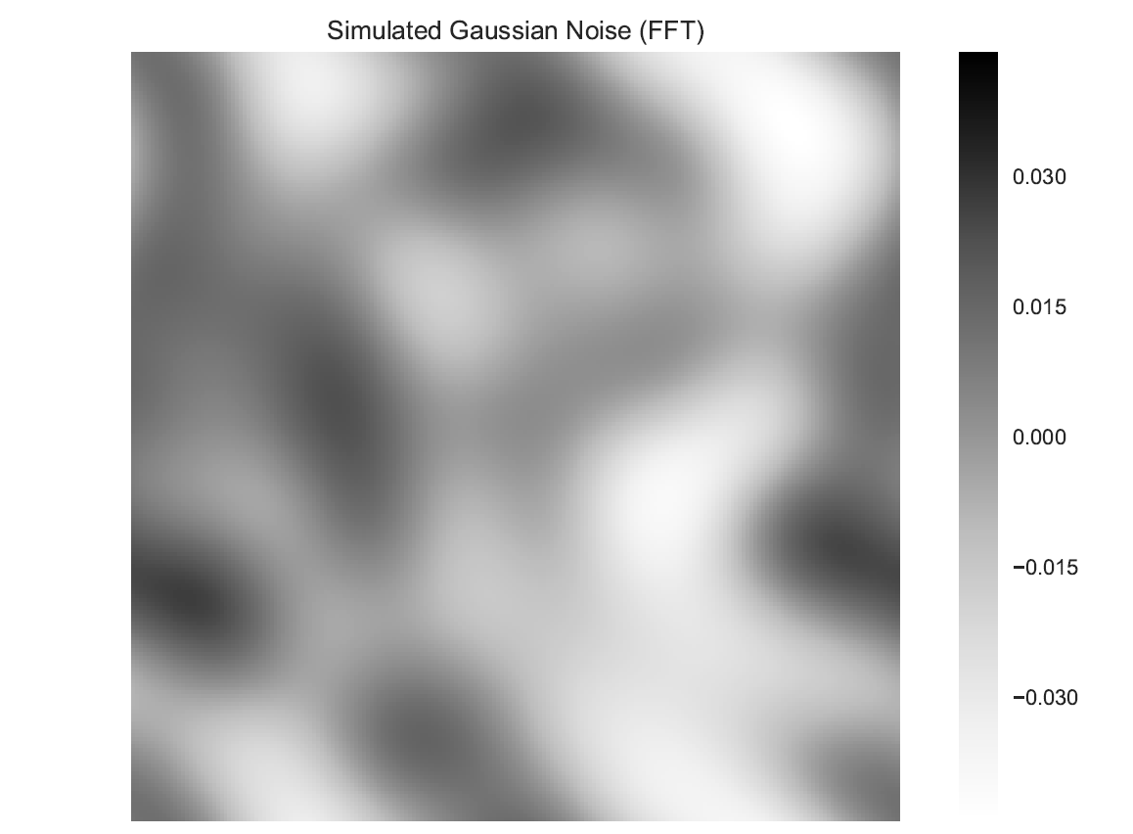
Simulated Data

Slide 9
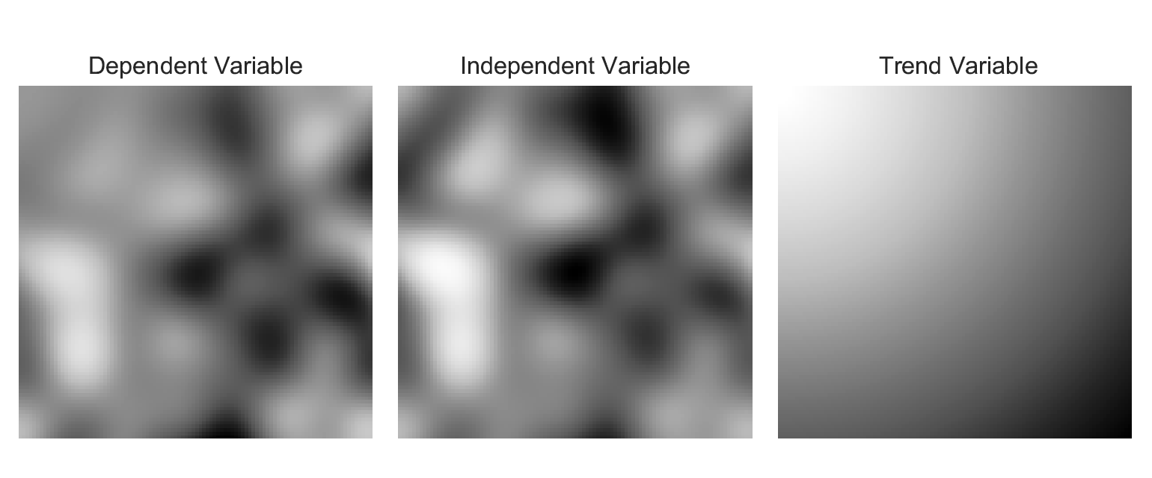
Simulated Data

Slide 10
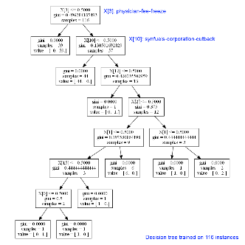
Methods
Training/Testing Framework
Decision Tree
Overfitting
Ensemble Learning
Random Forest
Bagging
Boosting
Gradient Boosted Regression
Notes:
For regression problems, boosting is a form of ‘functional gradient descent’. Consider a loss function – in this case, a measure (such as deviance) that represents the loss in predictive performance due to a suboptimal model. Boosting is a numerical optimization technique for minimizing the loss function by adding, at each step, a new tree that best reduces (steps down the gradient of) the loss function.For BRT, the first regression tree is the one that, for the selected tree size, maximally reduces the loss function. For each following step, the focus is on the residuals: on variation in the response that is not so far explained by the model.
For example, at the second step, a tree is fitted to the residuals of the first tree, and that second tree could contain quite different variables and split points compared with the first.
The final BRT model is a linear combination of many trees (usually hundreds to thousands) that can be thought of as a regression model where each term is a tree.
The model-building process performs best if it moves slowly down the gradient, so the contribution of each tree is usually shrunk by a learning rate that is substantially less than one.

Slide 11
Methods
GBRT
Stochastic
Model Parameters
Number of Estimators
Learning Rate <- Contribution of each tree
Loss Function <- Optimization parameter (least absolute deviation, least squares)
Minimum Samples at Leaf <- 1 - 3
Maximum Number of Nodes in a Tree <- Tree Complexity
Max Number of Features for splitting tree <- Auto
“subsample” - <1 = Stochastic GBRT (samples used to fit tree)
Model Selection
Grid Search Cross Validation
Scikit Learn Python Package
Elith, J., J. R. Leathwick, and T. Hastie. 2008. “A working guide to boosted regression trees.” Journal of Animal Ecology 77.
Notes:
The lr is used to shrink the contribution of each tree as it is added to the model. Decreasing (slowing) lr increases the number of trees required, and in general a smaller lr (and larger nt) are preferable,
stochasticity is controlled through a ‘bag fraction’ that specifies the proportion of data to be selected at each step.
Grid Search Cross Validation uses a metric to analyze the performance of the model, such as mean square error, and finds the combination of different parameter ranges to minimize that value.

Slide 12
Methods
Comparison Interpolation Methods
Inverse Distance Weighted (Squared or Cubed)
Deterministic
Ordinary Kriging
Stochastic
Single variable
ArcGIS Geostatistical Analyst
CoKriging
Multiple variables
Handles different sampled data (observations don’t have to be at the same location)
Models spatial autocorrelation individually for each variable, and covariance between variables
ArcGIS Geostatistical Analyst

Slide 13
Methods - Framework
Random sample of cells for interpolation
100 iterations
MSE, MAE, R^2
Independent Variables
Missing Value imputation
Nearest Neighbor, IDW, and Kriging
Encapsulating spatial dependence
Grid, distance from sample to grid location
? | ? | ?
? | ? | ?
? | ? | ?
? | ? | ?
? | ? | ?
10 | ? | ?
1 | ? | ?
? | 3 | ?
? | ? | ?
? | 5 | ?
Prediction Surface
Sampled Data
Explanatory Variable

Slide 14

Dimensions/Features/Independent Variables
$\begin{matrix}X & Y \\ ⋮ & ⋮ \\ n & n\end{matrix}$
$\begin{matrix}X & Y & GP1 \\ ⋮ & ⋮ & ⋮ \\ n & n & n\end{matrix} \begin{matrix}GP2 & GP3 & GP4 \\ ⋮ & ⋮ & ⋮ \\ n & n & n\end{matrix}$
$\begin{matrix}X & Y & IV \\ ⋮ & ⋮ & ⋮ \\ n & n & n\end{matrix} \begin{matrix}M \\ ⋮ \\ n\end{matrix}$

Slide 15
Results
Gaussian Field
Gradient Boosted Regression Vs. Inverse Distance Weighted

Slide 16
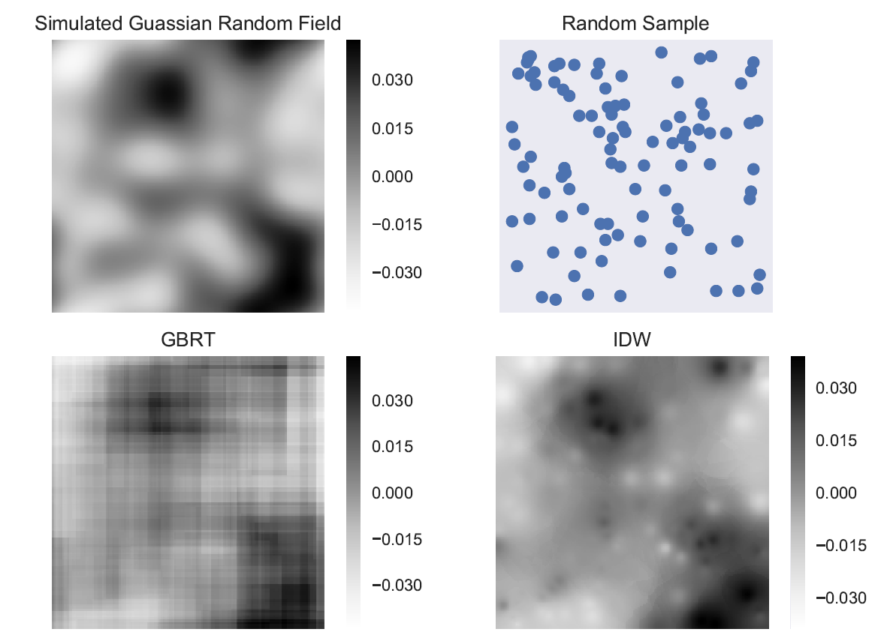

Slide 17
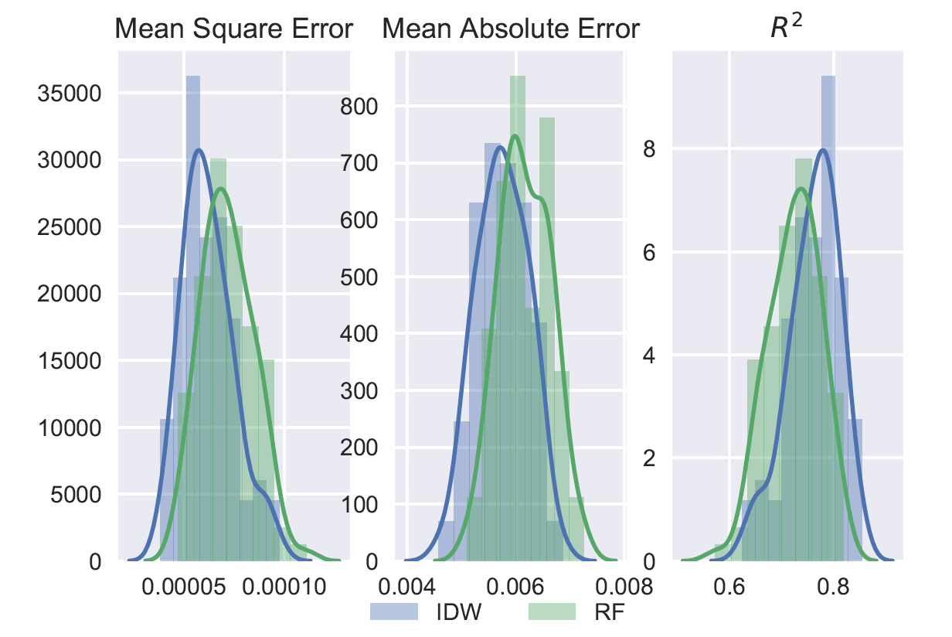

Slide 18
Results
Gaussian Field
Gradient Boosted Regression Vs. Inverse Distance Weighted
Spatial Depdence -> Gird

Slide 19
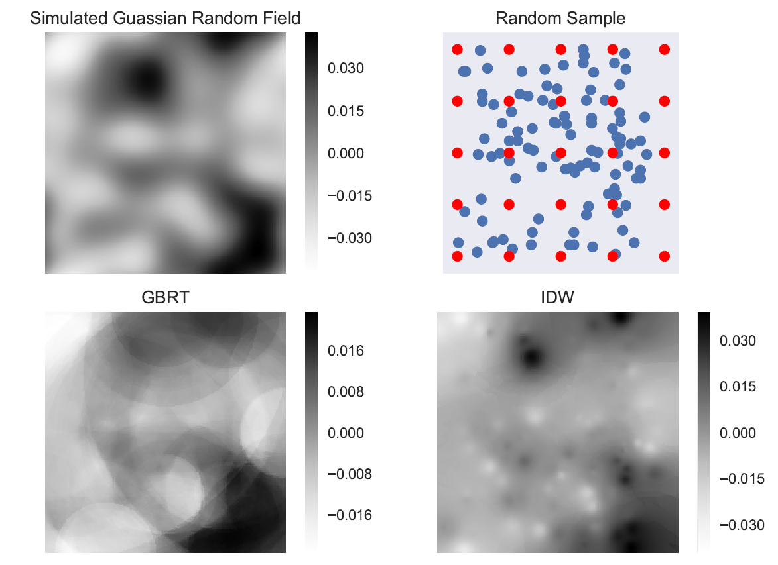

Slide 20
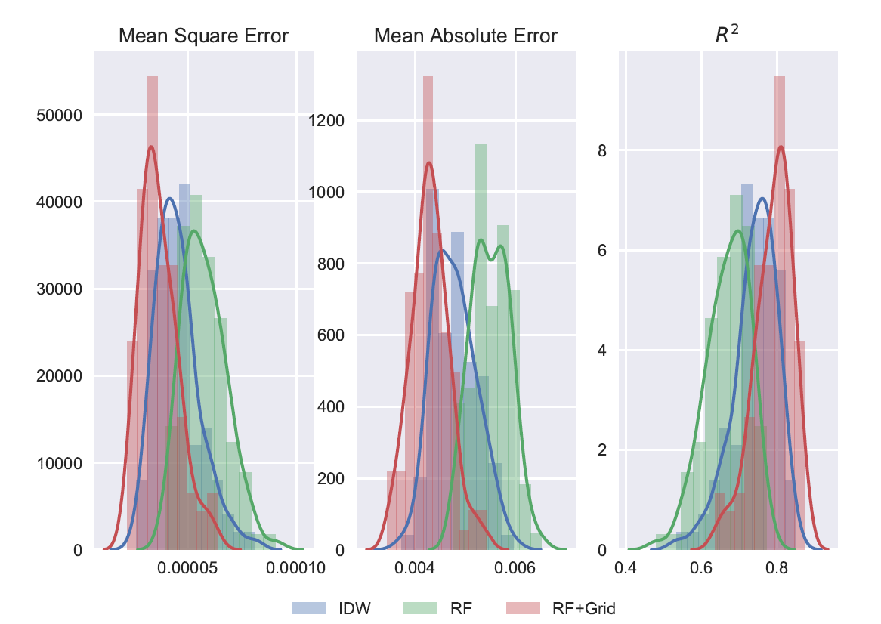

Slide 21
Results
Gaussian Field
Gradient Boosted Regression Vs. Co-Kriging
Spatial Depdence -> Gird
Independent Variable -> Nearest Neighbor Average, Inverse Distance Weighted, and Krigging
Co-Kriging handles this

Slide 22
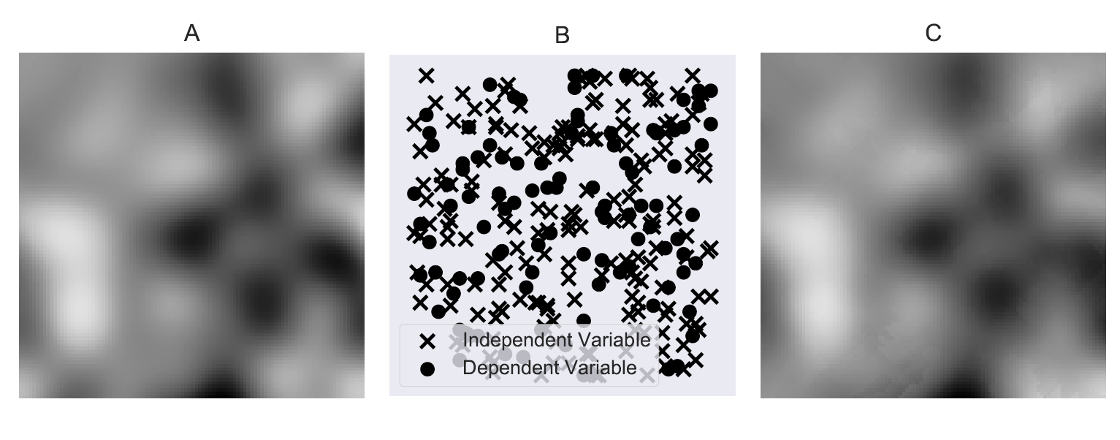
A - Simulated Gaussian Surface
B - Sample locations for dependent and independent variables
C - Co-Kriging Approach
Notes:
0.32763999729563015
0.3581176442727025
0.9542116440492512
A - Simulated Gaussian Surface
B - Sample locations for dependent and independent variables
C - Co-Kriging Approach

Slide 23
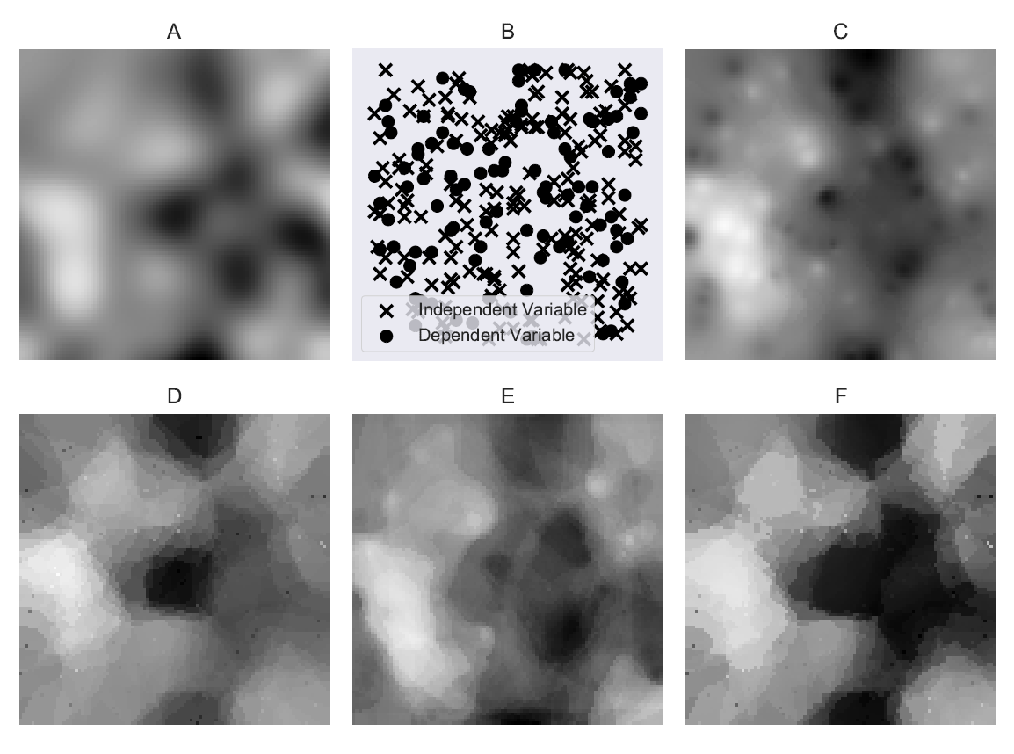
A - Simulated Gaussian Surface
B - Sample locations for dependent and independent variables
C - Inverse Distance Weighted surface of independent variable
D - Nearest Neighbor (7) interpolation
E - Predicted results using Gradient Boosted Regression Trees and the Inverse Distance Weighted Surface
F - Predicted results using Gradient Boosted Regression Trees and the Nearest Neighbor Surface
Notes:
NN MSE, MAE, R2
1.44922527671
0.895214340775
0.797467820258
IDW MSE, MAE, R2
1.91528946318
1.0022805292
0.732334402354
A - Simulated Gaussian Surface
B - Sample locations for depedent and independent variables
C - Inverse Distance Weighted surface of independent variable
D - Nearest Neighbor (7) interpolation
E - Predicted results using Gradient Boosted Regression Trees and the Inverse Distance Weighted Surface
F - Predicted results using Gradient Boosted Regression Trees and the Nearest Neighbor Surface

Slide 24
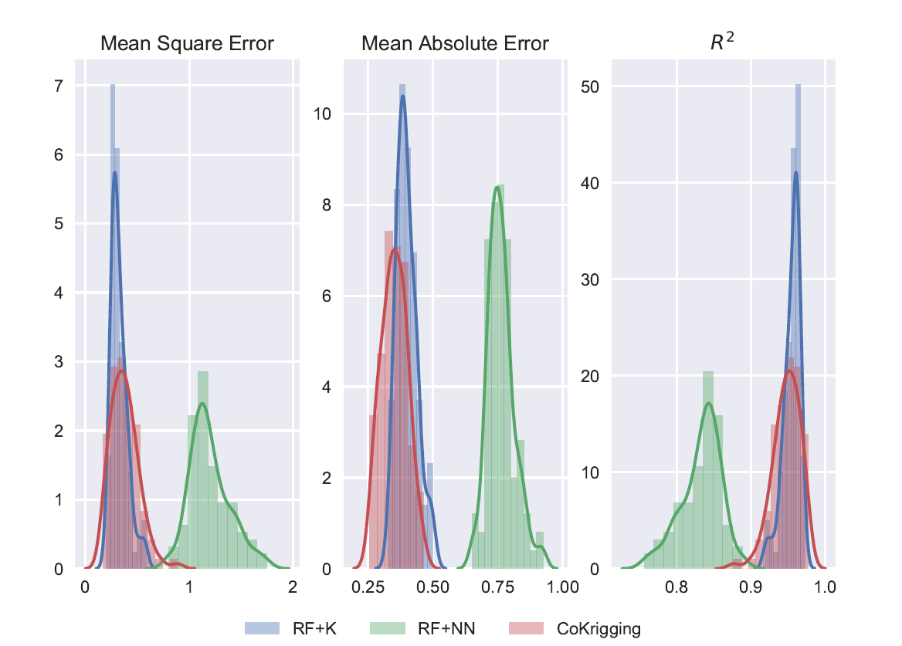
Notes:
Cokriging results

Slide 25
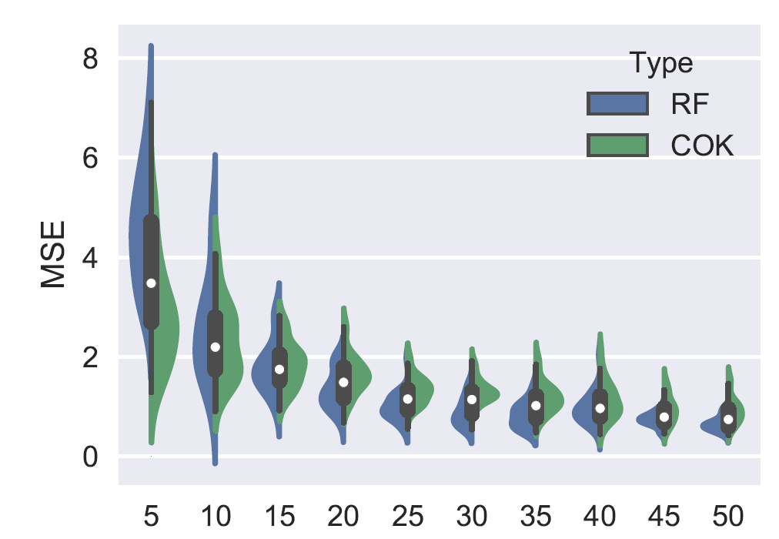
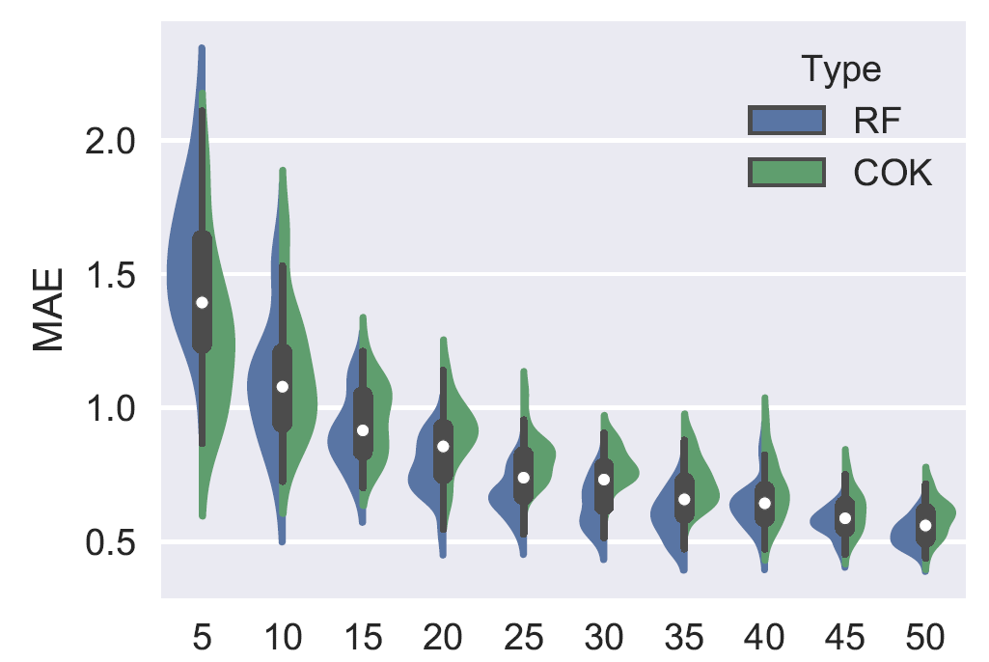

Slide 26
Conclusions
True performance may be confounded with the quality of the interpolation method of explanatory variables.
Co-Kriging may work better for <15 samples
Be aware of how spatial dependence is incorporated
Grid [performed better than IDW]
Features vs samples
Averaging, or combining the output with another interpolation method gives good results
Kriging applied to the RF’s residuals then added back
Liu, Ying, Guofeng Cao, Naizhuo Zhao, Kevin Mulligan, and Xinyue Ye. 2018. “Improve ground-level PM2.5 concentration mapping using a random forests-based geostatistical approach.” Environmental pollution (Barking, Essex : 1987) 235: 272–82.
Hengl, Tomislav, Gerard B. M. Heuvelink, Bas Kempen, Johan G. B. Leenaars, Markus G. Walsh, Keith D. Shepherd, Andrew Sila et al. 2015. “Mapping Soil Properties of Africa at 250 m Resolution: Random Forests Significantly Improve Current Predictions.” PloS one 10 (6): e0125814. doi:10.1371/journal.pone.0125814.
Li, Jin, Andrew D. Heap, Anna Potter, and James J. Daniell. 2011. “Application of machine learning methods to spatial interpolation of environmental variables.” Environmental Modelling & Software 26 (12): 1647–59. doi:10.1016/j.envsoft.2011.07.004.

Slide 27
Conclusions - Guidelines
Random Forest still has many advantages
Use an Ensemble Learning approach to combine variables of different distributions, and types
For sampled independent variables, use kriging to interpolate the variable

